Slide 1




Analysing the data
Analysis
Leverages cleaned .csv datasets
Concats team perf. with player attributes (i.e. win/loss record, off/def stats, team heights and salaries)
Groups the data by team and year
Statistics: means, correls, stdevs
Further analysis: OLS and t-test (SciPy) - timed out
Visualization libraries
Seaborn
Matplotlib.pyplot
Hvplot
Scatter
Bars
Mapbox/ Folium

Slide 2
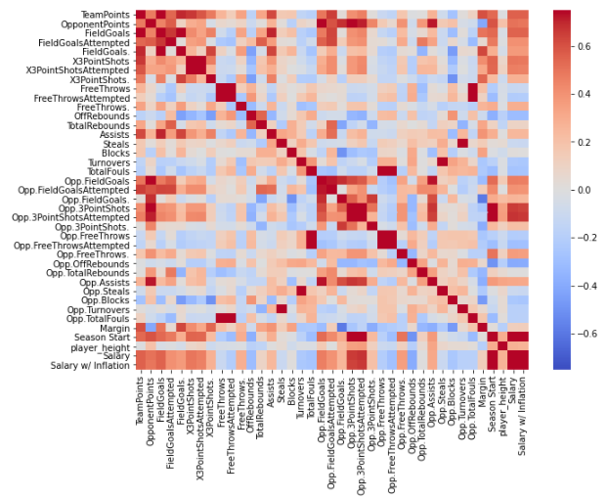
Correlations in team performance and player attributes?
Seaborn heatmap
Colormap is red (positive correl) through blue (negative correl)
Expect some stats to be serially correlated (e.g. points vs. field goals)
Observations
Medial positive correlation between team height, salary and margin
Strong correlation between salary and 3pt shots for/ against (causation? See: season!)

Slide 3
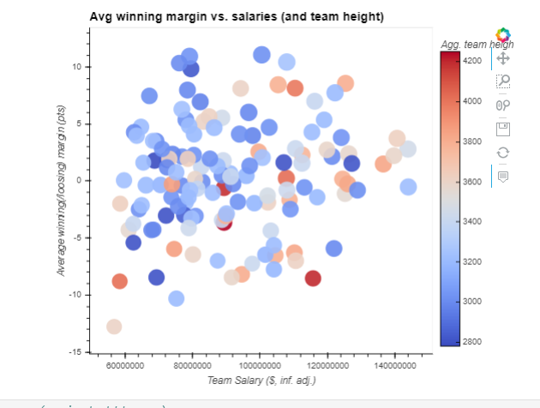
Team salary, winning margin and height
“Heart over height” - Nate Robinson
Hvplot scatter w/ extensive formatting
Each point is a team and a season (e.g. SAS, 2010) in range ‘08 - ‘18
Colormap is agg. team height (blue = smaller, red = taller)
Margin = average winning (or loosing) points margin by season
Observations
A tall, expensive team does not necessarily equate to winning margins over lookback

Slide 4
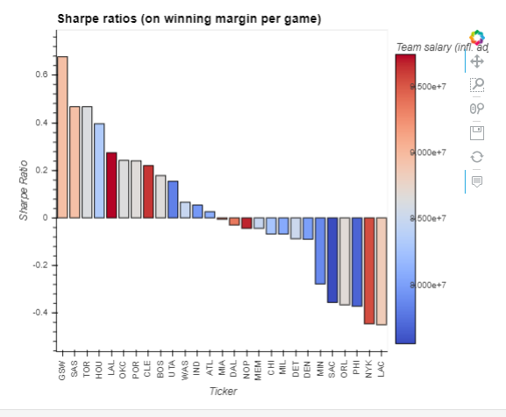
Sharpe Ratios
Gambler: “who tends to win?”
Owner: “does an expensive franchise give me consistent results?”
Calculates sharpe ratio on win/loss margins for each team, each game, over lookback period (‘08 -’18)
Sharpe = avg team margin - avg league margin / Stdev team margin
Observations
Avg. league margin ~zero (intuitive: zero sum game)
SAS/ GSW vs. LAL/ NYK?

